Slide 1
CARING FOR RESIDENTS WITH DEMENTIA IN LONG-TERM CARE
Diana Sturdevant Ph.D., GCNS-BC, APRN
Assistant Professor
Program Director, Nursing Home Quality Improvement Projects
Fran and Earl Ziegler College of Nursing
The University of Oklahoma Health Sciences Center
1100 N. Stonewall | Oklahoma City, OK 73117
405-271-1491, Ext. 49201 | diana-sturdevant@ouhsc.edu

Slide 2
Dementia
“Dementia is the loss of cognitive function—thinking, remembering, and reasoning—to such as extent that it interferes with a person’s daily life and activities. Some people with dementia cannot control their emotions, and their personalities may change. Dementia ranges in severity from the mildest stage, when it is just beginning to affect a person’s functioning, to the most severe stage, when the person must depend completely on others for basic activities of living.”
(National Institutes of Health, 2021)

Slide 3
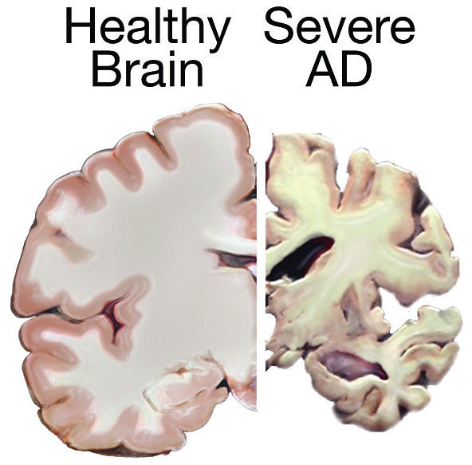
What Changes
Understanding language—BIG CHANGE!
Learning new and remembering:
Information, Place, Passage of time
Visual changes
Safety awareness
Impulse control
Ability to make choices
Start—sequence—complete—move on
Self-awareness
Ability to see another’s point of view

Slide 4
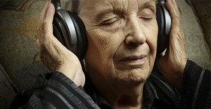
What Remains
Personality traits
Preferences—likes/dislikes
Key values
Joys and traumas
Bias and prejudices
Roles—Watch—Talk—Do
Rhythm—music—poetry—prayer

Slide 5
People living with dementia are doing the best they can
We must be willing to change ourselves

Slide 6
What can be controlled? Or not?
Control Not Control
Environment- setting, The person’s personality,
sounds, sights preferences, and history
Our approach, behaviors, Type and level of impairment
words, actions, and
reactions Other medical conditions and
sensory status

Slide 7
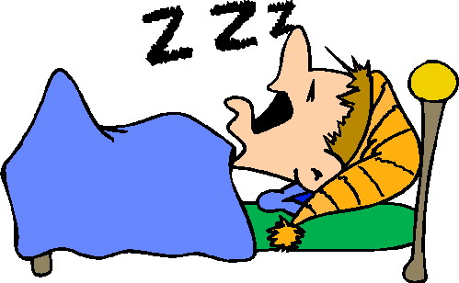
Top Five Unmet Needs
Hydration and Nourishment
Wake-sleep and active-rest cycles
Elimination
Find Comfort
Pain:
Physical
Emotional
Spiritual

Slide 8
Signals of Emotional Distress
Angry
Sad
Lonely
Scared
Bored/Lacking Purpose

Slide 9
Approach
Visual—smile, friendly, concerned
Verbal—tone of voice, use name (preferred)
Touch—only after establishing connection

Slide 10
Dos and Don’ts
Do smile
Go slow, don’t rush
Do use distraction
Do use visual cues
Don’t ask them if they remember
Do with, not to, or for

Slide 11
Recognize when your approach is not working
Stop what you are doing
Back off and re-think
Change something
Try again or let someone else
Let it go

Slide 12
Behavior…or response?
What makes situations happen?
The Person—personality, preferences, history
Health & Wellness—medical conditions, medications, sensory
Brain Changes—type and level of cognitive impairment
Caregivers—approach, behaviors, words, actions, reactions
Environment—setting, sounds, sights

Slide 13
4Ms: Mentation
Prevent, identify, treat, and manage dementia, depression, and delirium across settings of care.

Slide 15
Thank You!
Diana Sturdevant diana-sturdevant@ouhsc.edu

Slide 16
Questions?
This Photo by Unknown Author is licensed under CC BY-NC

